Slide 1
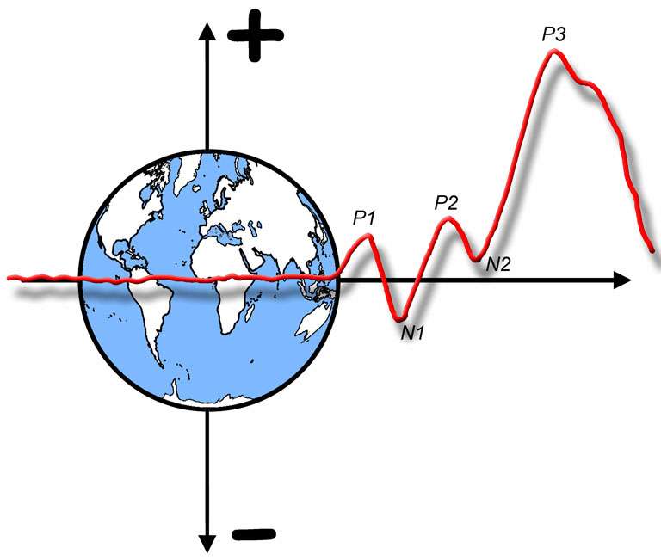

The ERP Boot Camp
Miscellaneous stuff that will keep coming up so I should just go ahead and talk about it now

Slide 2
Overview
EEG frequency bands
Averaging and Phase Resetting
Filters and Fourier analysis
Baseline correction
Overlap
Difference waves
Order of data processing steps
Some key ERP components
Notes:
© S. J. Luck. All Rights Reserved. May be used for nonprofit educational purposes if this copyright notice is included. Permission must be obtained from the copyright holder(s) for any other use.

Slide 3
Major EEG Bands
Raw EEG
Delta (1-3 Hz)
Slow Wave Sleep
Theta (4-7 Hz)
Non-REM Sleep
Misc Cognitive
https://en.wikipedia.org/wiki/Eeg
Notes:
http://en.wikipedia.org/wiki/Eeg

Slide 4
Major EEG Bands
Alpha (8-12 Hz)
Awake, Relaxed
(Zoning)
Beta (12-25 Hz)
Mentally Active
Gamma (25+ Hz)
Local Synchrony?
https://en.wikipedia.org/wiki/Eeg
Notes:
http://en.wikipedia.org/wiki/Eeg

Slide 5
Averaging
Voltage
Time
Notes:
© S. J. Luck. All Rights Reserved. May be used for nonprofit educational purposes if this copyright notice is included. Permission must be obtained from the copyright holder(s) for any other use.

Slide 6
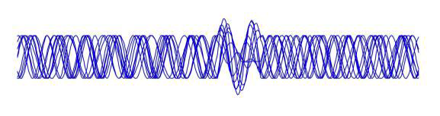
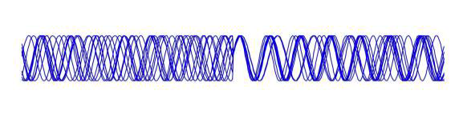
Phase Resetting
Addition of transient response to ongoing oscillation
Stimulus
Phase resetting of ongoing oscillation
Stimulus
For details, see Bastiaansen et al chapter in The Oxford Handbook of ERP Components
Courtesy of T. Picton
Notes:
© S. J. Luck. All Rights Reserved. May be used for nonprofit educational purposes if this copyright notice is included. Permission must be obtained from the copyright holder(s) for any other use.

Slide 7
Fourier Analysis & Filtering
The raw EEG is, in part, the sum of multiple oscillations at different frequencies
https://en.wikipedia.org/wiki/Eeg
Raw EEG
Fourier analysis allows us to recover the original frequencies from the sum
Notes:
EEG from http://en.wikipedia.org/wiki/Eeg
All other content © S. J. Luck. All Rights Reserved. May be used for nonprofit educational purposes if this copyright notice is included. Permission must be obtained from the copyright holder(s) for any other use.

Slide 8
Fourier Analysis
Time Domain
Frequency Domain
Fourier Transform
Amplitude (or Power)
Inverse Fourier Transform
(Phase, too!)
Any waveform is equivalent to the sum of a set of sine waves of different frequencies, amplitudes and phases
Time domain: Amplitude as a function of time
Frequency domain: Amplitude and phase as a function of frequency
Fourier transform converts time domain to frequency domain
Inverse Fourier transform converts frequency domain to time domain
Notes:
All other content © S. J. Luck. All Rights Reserved. May be used for nonprofit educational purposes if this copyright notice is included. Permission must be obtained from the copyright holder(s) for any other use.

Slide 9
Filtering
Low-pass filter: Remove high frequencies, pass low frequencies
Notes:
© S. J. Luck. All Rights Reserved. May be used for nonprofit educational purposes if this copyright notice is included. Permission must be obtained from the copyright holder(s) for any other use.

Slide 10
Filtering
High-pass filter: Remove low frequencies, high low frequencies
Extreme filters can significantly distort an ERP waveform
Notes:
© S. J. Luck. All Rights Reserved. May be used for nonprofit educational purposes if this copyright notice is included. Permission must be obtained from the copyright holder(s) for any other use.

Slide 11
Filtering
High-pass filter: Remove low frequencies, high low frequencies
EEG,
Unfiltered
EEG,
Filtered @ 0.1 Hz
Notes:
Figure 7.6 from from Luck, S.J. (2014). An Introduction to the Event-Related Potential Technique, Second Edition. Cambridge, MA: MIT Press. © MIT Press.
This material may be used for nonprofit research and education purposes only, and it may not be reprinted or distributed in any form including print and electronic forms.

Slide 12
Segmenting & Baselining
Prior to averaging, we must extract segments (epochs) of the EEG surrounding the relevant events
Baseline correction is usually performed at this point
This is important for some types of artifact rejection procedures (e.g., absolute voltage thresholds)
For most purposes, baseline correction can be performed at any time
Voltage
Time
Notes:
© S. J. Luck. All Rights Reserved. May be used for nonprofit educational purposes if this copyright notice is included. Permission must be obtained from the copyright holder(s) for any other use.

Slide 13
Reason 1: DC Offset
115 µV
Notes:
© S. J. Luck. All Rights Reserved. May be used for nonprofit educational purposes if this copyright notice is included. Permission must be obtained from the copyright holder(s) for any other use.

Slide 14
Reason 2: Baseline Drift
Notes:
© S. J. Luck. All Rights Reserved. May be used for nonprofit educational purposes if this copyright notice is included. Permission must be obtained from the copyright holder(s) for any other use.

Slide 15
How to Correct Baseline
Goal: Subtract estimate of DC offset from the waveform
Mean prestimulus voltage is usually a reasonable estimate
Subtract this value from each point in the waveform
Anything that messes up the baseline (e.g., noise, overlap) will be propagated to your amplitude measurements
Notes:
© S. J. Luck. All Rights Reserved. May be used for nonprofit educational purposes if this copyright notice is included. Permission must be obtained from the copyright holder(s) for any other use.

Slide 16
Baseline Noise Example
Entire waveform shifted down (negative) because of positive noise blip
Notes:
© S. J. Luck. All Rights Reserved. May be used for nonprofit educational purposes if this copyright notice is included. Permission must be obtained from the copyright holder(s) for any other use.

Slide 17
Differential Overlap
Notes:
© S. J. Luck. All Rights Reserved. May be used for nonprofit educational purposes if this copyright notice is included. Permission must be obtained from the copyright holder(s) for any other use.

Slide 18
Drift Over Time
However, if you are looking at EEG activity in specific frequency bands (e.g., alpha activity), slow drifts in DC offset have no impact, so you can look over a longer time period.
Notes:
© S. J. Luck. All Rights Reserved. May be used for nonprofit educational purposes if this copyright notice is included. Permission must be obtained from the copyright holder(s) for any other use.

Slide 19
What to look for…
Notes:
© S. J. Luck. All Rights Reserved. May be used for nonprofit educational purposes if this copyright notice is included. Permission must be obtained from the copyright holder(s) for any other use.

Slide 20
Response-Locked Baseline
What to use for response-locked averages?
A period that is equivalent across conditions
Often, only the prestimulus period is guaranteed to be equivalent
Simple option-
Average using a long pre-response interval and use a time range that is prior to the stimulus on (almost) every trial
Complex option-
Use the prestimulus period for each individual trial
Notes:
© S. J. Luck. All Rights Reserved. May be used for nonprofit educational purposes if this copyright notice is included. Permission must be obtained from the copyright holder(s) for any other use.

Slide 21
Difference Waves
If a single component varies across conditions, it can be isolated by means of a difference wave
For this to work, the conditions must be so similar that only one component varies across conditions
Notes:
© S. J. Luck. All Rights Reserved. May be used for nonprofit educational purposes if this copyright notice is included. Permission must be obtained from the copyright holder(s) for any other use.

Slide 22
Slope Illusion
Notes:
© S. J. Luck. All Rights Reserved. May be used for nonprofit educational purposes if this copyright notice is included. Permission must be obtained from the copyright holder(s) for any other use.

Slide 23
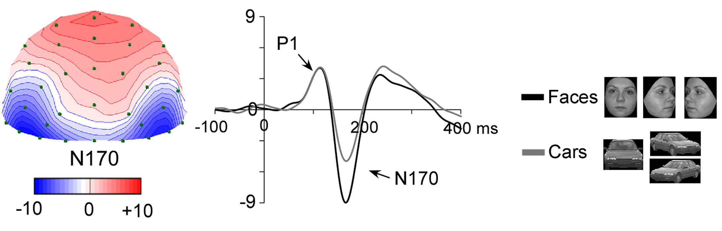
Example: N170
This voltage reflects face-related activity plus everything else that is active at 170 ms
Rossion & Jacques (2009)
Notes:
From Rossion, B., & Jacques, C. (2012). The N170: Understanding the time course of face perception in the human brain. In S. J. Luck & E. S. Kappenman (Eds.), Oxford Handbook of Event-Related Potential Components. New York: Oxford University Press. © Oxford University Press.

Slide 24
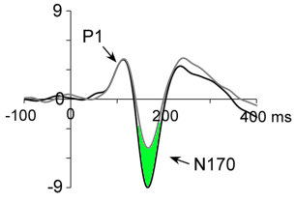
Example: N170
This difference reflects only brain activity that differentiates between faces and cars
Rossion & Jacques (2009)
Notes:
From Rossion, B., & Jacques, C. (2012). The N170: Understanding the time course of face perception in the human brain. In S. J. Luck & E. S. Kappenman (Eds.), Oxford Handbook of Event-Related Potential Components. New York: Oxford University Press. © Oxford University Press.

Slide 25
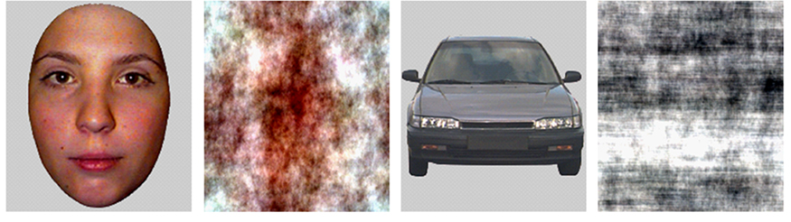
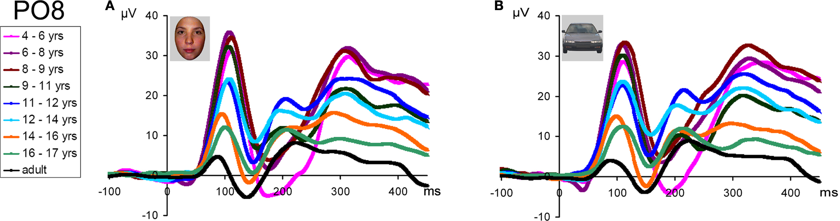
N170 and Development
Faces
Scrambled Faces
Cars
Scrambled Cars
Kuefner et al (2010, Frontiers in Human Neuroscience)
Notes:
Figure 8 from Kuefner, D., de Heering, A., Jacques, C., Palmero-Soler, E., & Rossion, B. (2010). Early Visually Evoked Electrophysiological Responses Over the Human Brain (P1, N170) Show Stable Patterns of Face-Sensitivity from 4 years to Adulthood. Frontiers in human neuroscience, 3, 67. Open access publication.

Slide 26
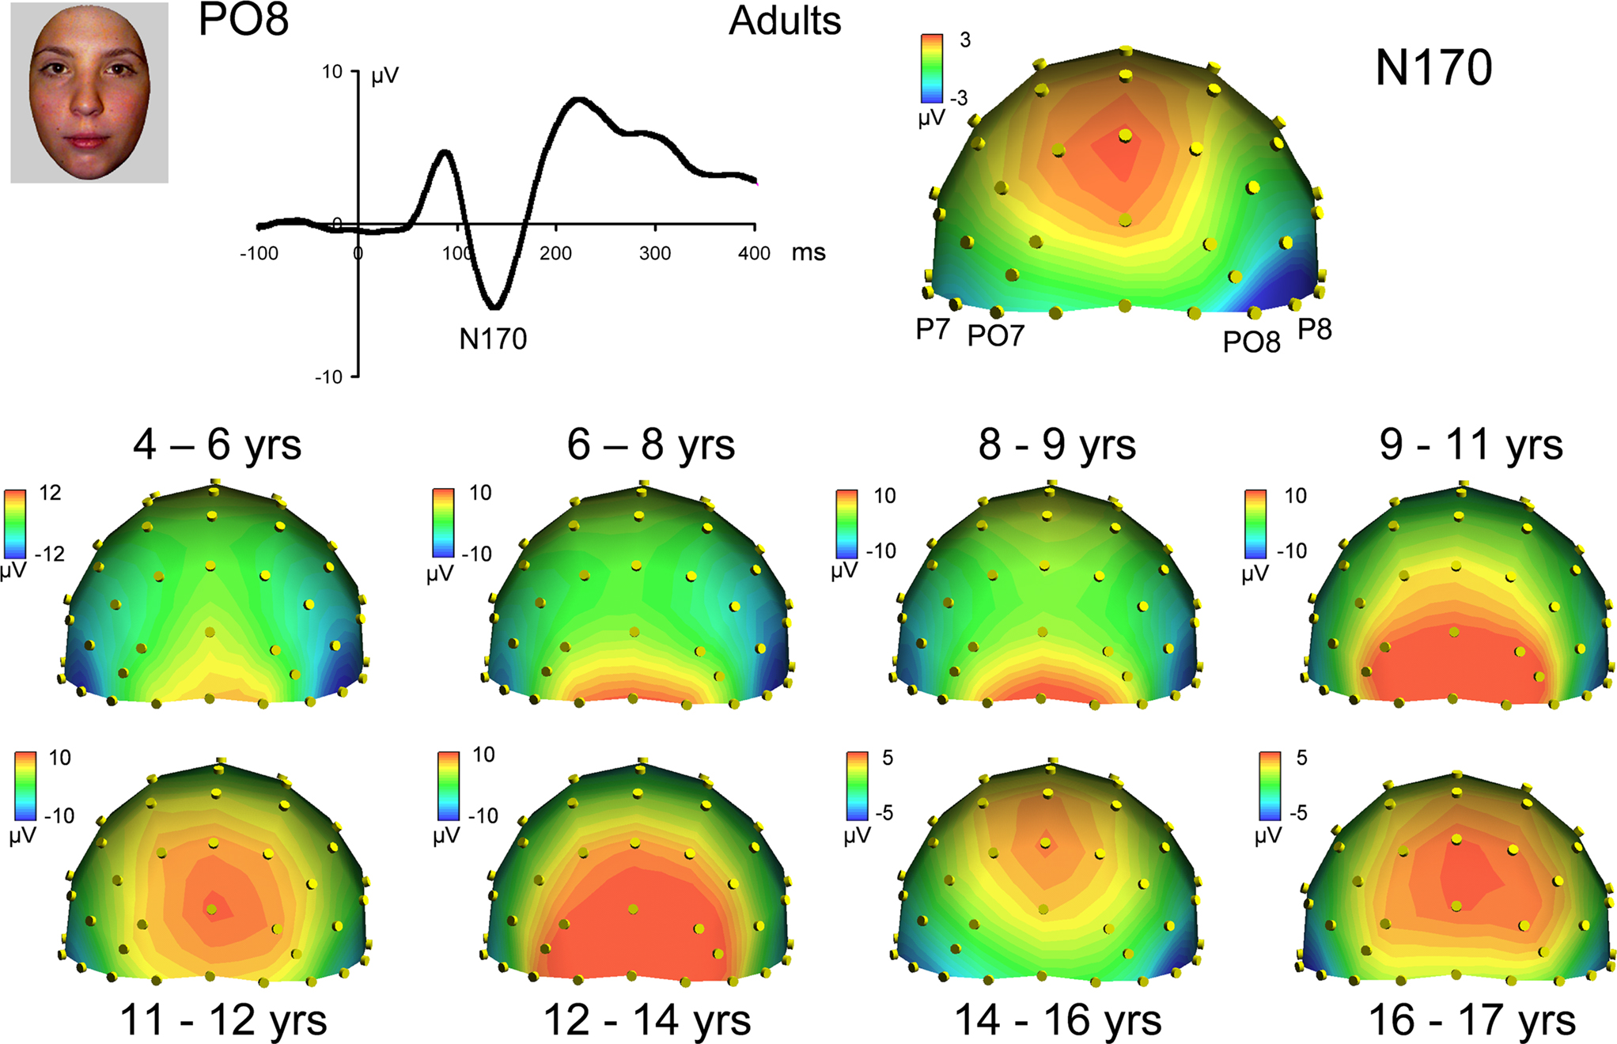
It looks like the N170 scalp distribution changes over development
But this could be due to other components in this time range
Kuefner et al (2010, Frontiers in Human Neuroscience)
Notes:
Figure 7 from Kuefner, D., de Heering, A., Jacques, C., Palmero-Soler, E., & Rossion, B. (2010). Early Visually Evoked Electrophysiological Responses Over the Human Brain (P1, N170) Show Stable Patterns of Face-Sensitivity from 4 years to Adulthood. Frontiers in human neuroscience, 3, 67. Open access publication.

Slide 27
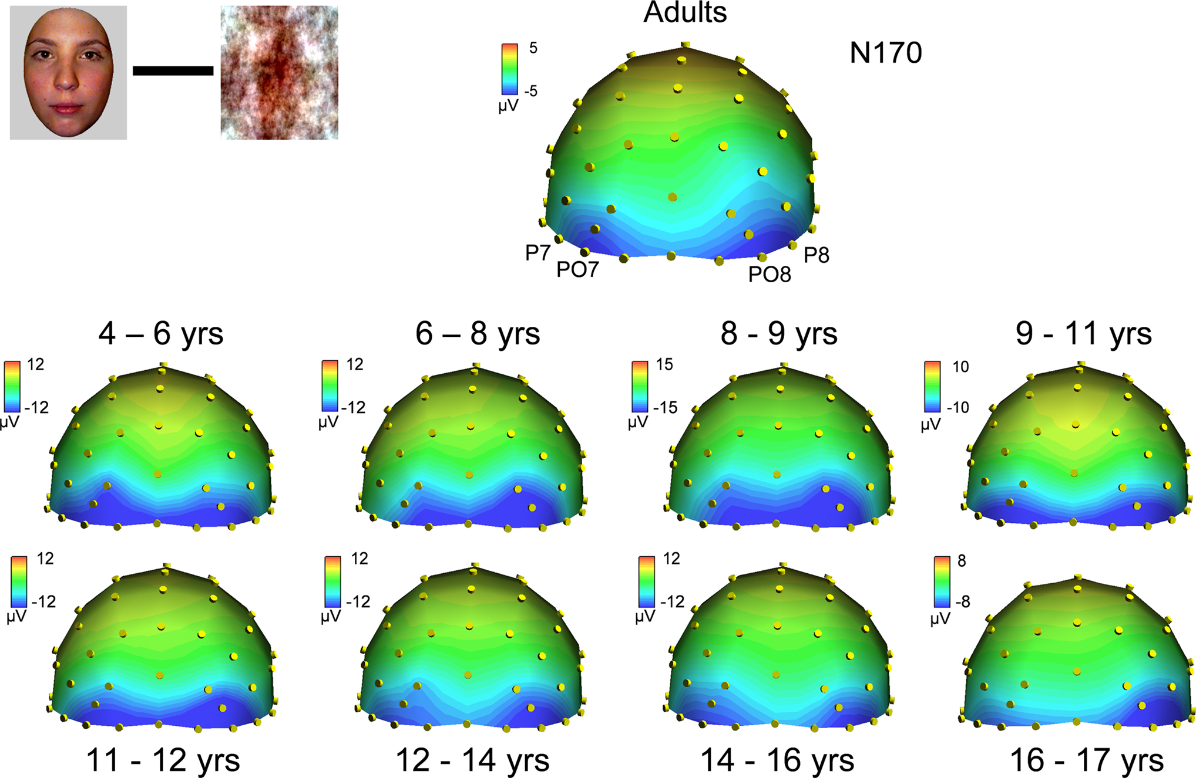
Subtracting scrambled faces removes nonspecific activity
The face-specific activity has the same distribution over development
Kuefner et al (2010, Frontiers in Human Neuroscience)
Notes:
Figure 9 from Kuefner, D., de Heering, A., Jacques, C., Palmero-Soler, E., & Rossion, B. (2010). Early Visually Evoked Electrophysiological Responses Over the Human Brain (P1, N170) Show Stable Patterns of Face-Sensitivity from 4 years to Adulthood. Frontiers in human neuroscience, 3, 67. Open access publication.

Slide 28
Shortcomings of Difference Waves
May not isolate a single component
Example: Rare-Frequent yields P2, N2, P3
If Cond1–Cond2 difference wave is reduced, cannot distinguish between smaller Cond1 and larger Cond2
For most components, need to look at original waveforms as well as difference waves
Changes in latency between Cond1 and Cond2 produce an apparent difference in amplitude
Not a problem if you view difference wave as simply meaning a difference in the time course of amplitude
Notes:
© S. J. Luck. All Rights Reserved. May be used for nonprofit educational purposes if this copyright notice is included. Permission must be obtained from the copyright holder(s) for any other use.

Slide 29
Order of Processing Steps
The order of operations does not matter for “linear operations”
Example: Averaging and re-referencing are both linear operations
Re-referencing before or after averaging yields exactly the same result
Artifact rejection is nonlinear
Re-reference before rejection if it helps rejection
Same principles apply to linear filters, except that nonlinearities are introduced at edges of waveform
See Appendix in 2nd Edition of ERP book for a list of the typical order of processing steps
Notes:
© S. J. Luck. All Rights Reserved. May be used for nonprofit educational purposes if this copyright notice is included. Permission must be obtained from the copyright holder(s) for any other use.

Slide 30
Linear Operations
y = c + bx Simple line
y = c + b₁x₁ + b₂x₂ + b₃x₃ … Multiple regression
y = ⅓x₁ + ⅓x₂ + ⅓x₃ Averaging
y = ch1+ (-.5)ch14 Re-referencing
Not linear if it involves a threshold Artifact rejection
or comparison Peaks
or multiplying/dividing data values y = ch1²
Notes:
© S. J. Luck. All Rights Reserved. May be used for nonprofit educational purposes if this copyright notice is included. Permission must be obtained from the copyright holder(s) for any other use.

Slide 31
P3, Probability, & Stimulus Evaluation Time
P3 amplitude depends on the probability of a task-defined stimulus category
P3 effect cannot occur until after categorization
P3 latency is tied to the amount of time required to perceive and categorize a stimulus (“stimulus evaluation time”)
Notes:
© S. J. Luck. All Rights Reserved. May be used for nonprofit educational purposes if this copyright notice is included. Permission must be obtained from the copyright holder(s) for any other use.

Slide 32
A Gedankenexperiment
Oddball task
Single-Digit condition: Rare = 5; Frequent = 0-4,6-9
Odd-Even condition: Rare = odd; Frequent = even
Single-Digit should be categorized faster than Odd-Even
Notes:
© S. J. Luck. All Rights Reserved. May be used for nonprofit educational purposes if this copyright notice is included. Permission must be obtained from the copyright holder(s) for any other use.

Slide 33
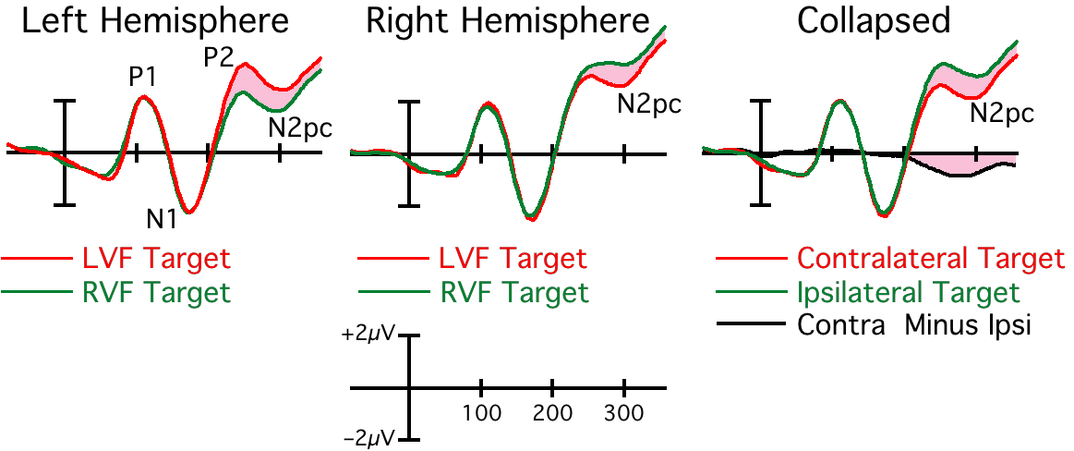
The N2pc Component
Difference cannot exceed zero until the brain has found the to-be-attended object
Notes:
© S. J. Luck. All Rights Reserved. May be used for nonprofit educational purposes if this copyright notice is included. Permission must be obtained from the copyright holder(s) for any other use.

Slide 34
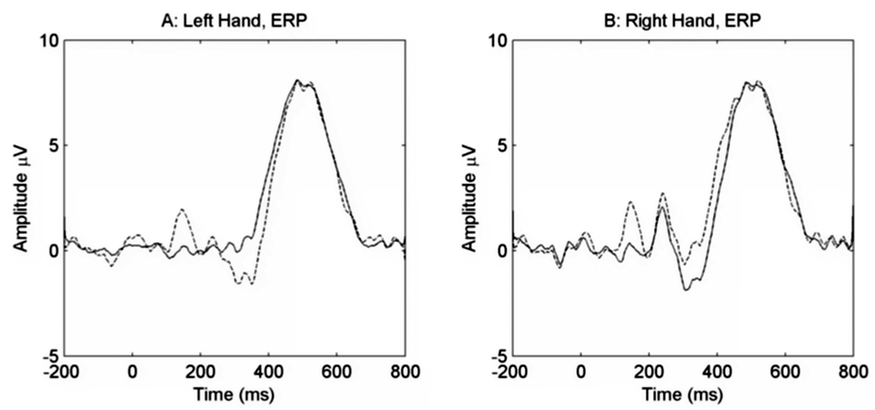
The Lateralized Readiness Potential (LRP)
Left Hemisphere
(Ipsi)
Right Hemisphere
(Ipsi)
Right Hemisphere
(Contra)
Left Hemisphere
(Contra)
LRP = Contra minus ipsi, averaged over left & right hands
Smulders & Miller (2010)
Notes:
Adapted from Smulders, F. T. Y., & Miller, J. O. (2012). Lateralized Readiness Potential. In S. J. Luck & E. S. Kappenman (Eds.), Oxford Handbook of Event-Related Potential Components. New York: Oxford University Press. © Oxford University Press.

Slide 35
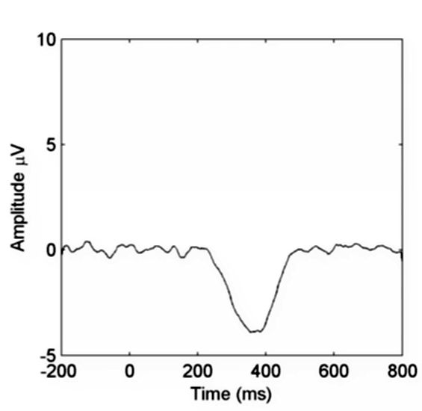
The Lateralized Readiness Potential (LRP)
LRP = Contra minus ipsi, averaged over left & right hands
Difference cannot exceed zero until the brain has begun to determine which hand is appropriate for the current stimulus
Smulders & Miller (2010)
Notes:
Adapted from Smulders, F. T. Y., & Miller, J. O. (2012). Lateralized Readiness Potential. In S. J. Luck & E. S. Kappenman (Eds.), Oxford Handbook of Event-Related Potential Components. New York: Oxford University Press. © Oxford University Press.

Slide 36
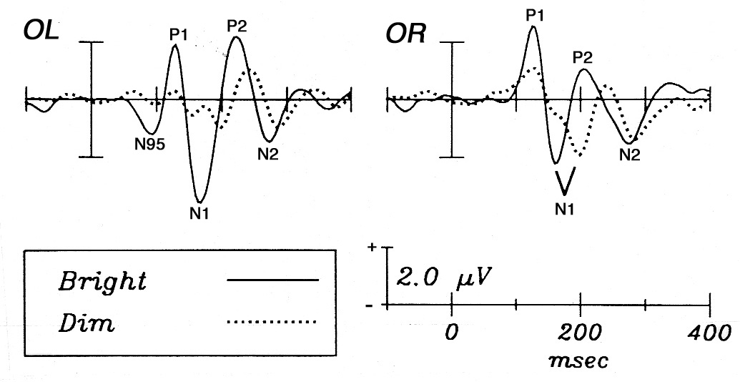
Visual Sensory Responses
P1: Extrastriate cortex; Sensitive to visual features, arousal, and attention
N1: Extrastriate, parietal, and frontal subcomponents; sensitive to attention; N170 is a subcomponent
P1
N1
Vogel & Luck (2000)
Johannes et al. (1995)
Notes:
Left panel from Vogel, E.K., Luck, S.J., & Shapiro, K.L. (1998). Electrophysiological evidence for a postperceptual locus of suppression during the attentional blink. Journal of Experimental Psychology: Human Perception and Performance, 24, 1656-1674.
Right panel from Johannes, S., Knalmann, U., Heinze, H.J., & Mangun, G.R. (1995). Luminance and spatial attention effects on early visual processing. Cognitive Brain Research, 2, 189-205.
Other content: © S. J. Luck. All Rights Reserved. May be used for nonprofit educational purposes if this copyright notice is included. Permission must be obtained from the copyright holder(s) for any other use.

Slide 37
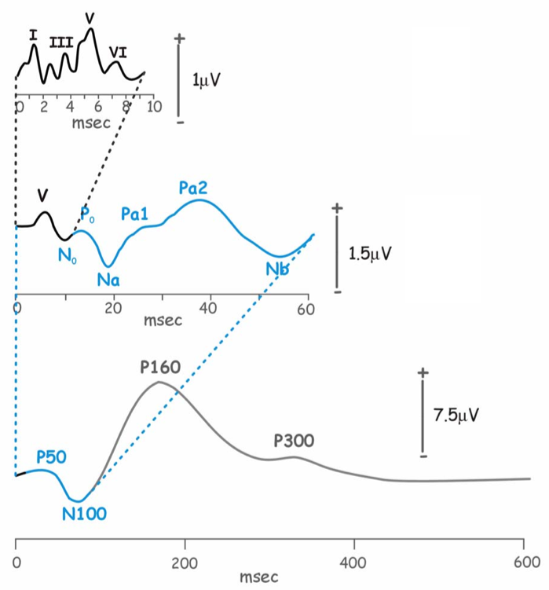
Auditory Sensory Responses
Brainstem auditory evoked responses (BAERs; aka auditory brainstem responses or ABRs)
Brief clicks used as stimuli
Cochlea, auditory nerve, brainstem nuclei
Midlatency responses (MLRs)
Medial geniculate nucleus and primary auditory cortex
Modulated by highly focused attention
Auditory “long-latency” sensory responses
At least 3 N1 subcomponents
Sensitive to attention
Pratt (2012, Oxford Handbook of ERP Components)
Notes:
From Pratt, H. (2012). Sensory ERP components. In S. J. Luck & E. S. Kappenman (Eds.), Oxford Handbook of Event-Related Potential Components. New York: Oxford University Press. © Oxford University Press.

Slide 38
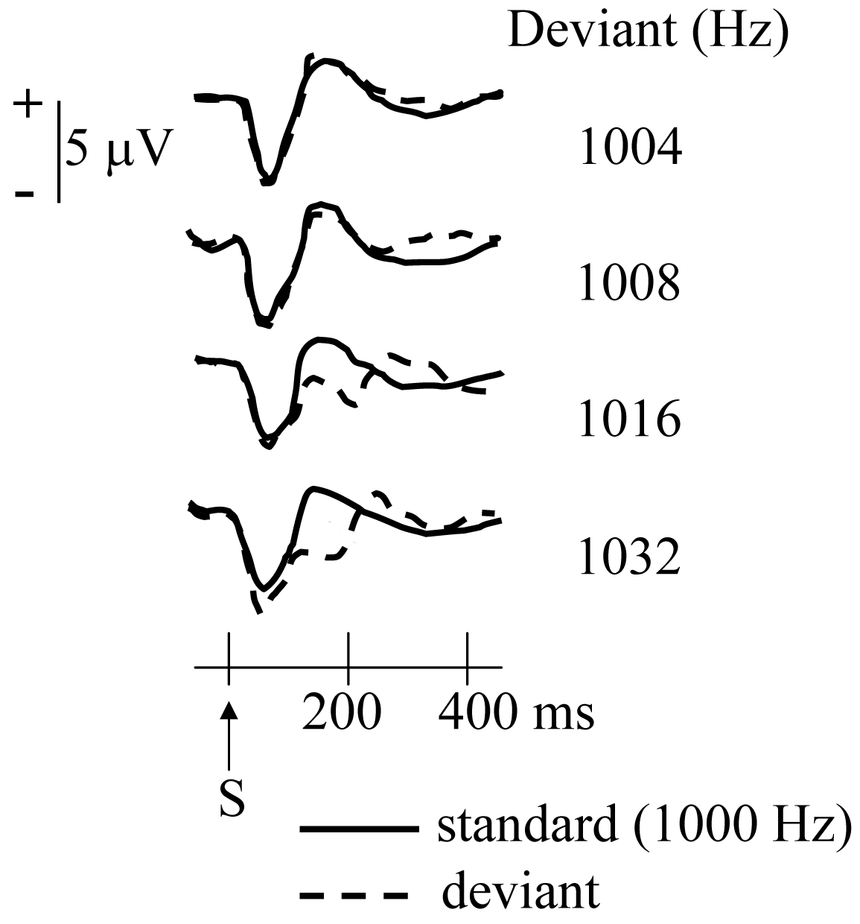
Mismatch Negativity (MMN)
Elicited by an auditory stimulus that physically mismatches preceding stimuli
Generated in auditory cortex
Appears to reflect comparison of incoming stimulus with echoic memory
Largely automatic, but can be attenuated when attention is strongly focused on a different auditory source
Näätänen and Kreegipuu (2012, Oxford Handbook of ERP Components)
Notes:
Waveforms from Näätänen, R., & Kreegipuu, K. (2012). The mismatch negativity (MMN). In S. J. Luck & E. S. Kappenman (Eds.), The Oxford Handbook of Event-Related Potential Components (pp. 143-157). New York: Oxford University Press. © Oxford University Press.
Other content: © S. J. Luck. All Rights Reserved. May be used for nonprofit educational purposes if this copyright notice is included. Permission must be obtained from the copyright holder(s) for any other use.

Slide 39
N400
Typical paradigm: Establish a semantic context and then violate it
I take my coffee with cream and sugar
+
–
I take my coffee with cream and dog
Notes:
© S. J. Luck. All Rights Reserved. May be used for nonprofit educational purposes if this copyright notice is included. Permission must be obtained from the copyright holder(s) for any other use.

Slide 40
The Error-Related Negativity
Independently discovered by Falkenstein and Gehring
Notes:
© S. J. Luck. All Rights Reserved. May be used for nonprofit educational purposes if this copyright notice is included. Permission must be obtained from the copyright holder(s) for any other use.

Slide 41
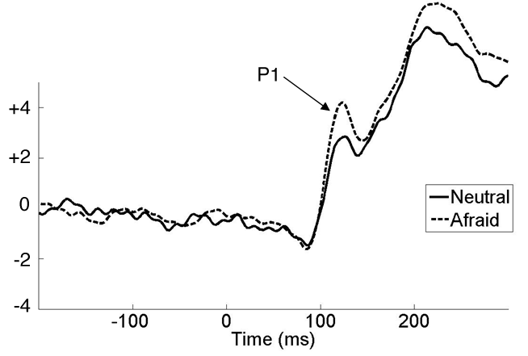
Emotion-Related Components: P1
Hard to rule out low-level sensory factors (but maybe our sensory systems are tuned to emotion-relevant low-level features)
Hajcak et al. (2012, Oxford Handbook of ERP Components)
Notes:
Adapted from Hajcak, G., Wienberg, A., MacNamara, A., & Foti, D. (2012). ERPs and the study of emotion. In S. J. Luck & E. S. Kappenman (Eds.), The Oxford Handbook of Event-Related Potential Components (pp. 441-472). New York: Oxford University Press. © Oxford University Press.

Slide 42
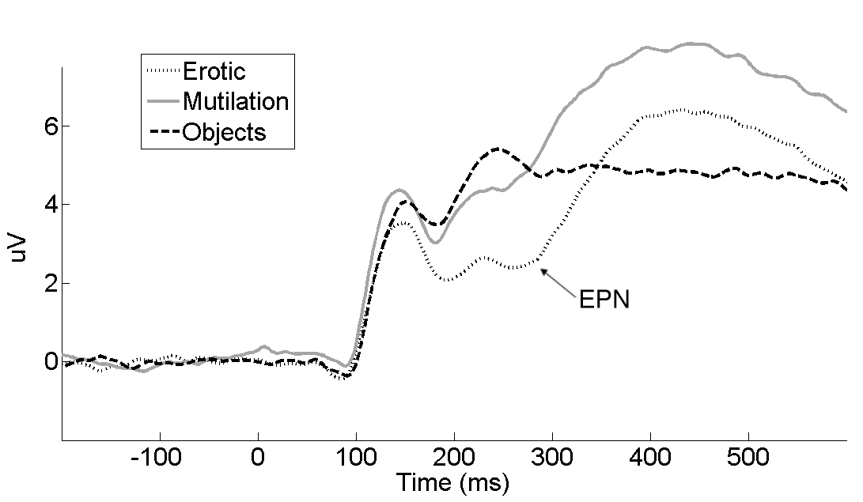
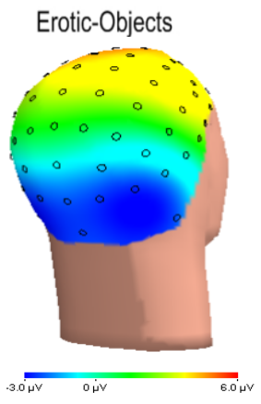
Emotion-Related Components: EPN
Early Posterior Negativity
May reflect allocation of attention to emotional content of image
Hajcak et al. (2012, Oxford Handbook of ERP Components)
Notes:
Adapted from Hajcak, G., Wienberg, A., MacNamara, A., & Foti, D. (2012). ERPs and the study of emotion. In S. J. Luck & E. S. Kappenman (Eds.), The Oxford Handbook of Event-Related Potential Components (pp. 441-472). New York: Oxford University Press. © Oxford University Press.

Slide 43
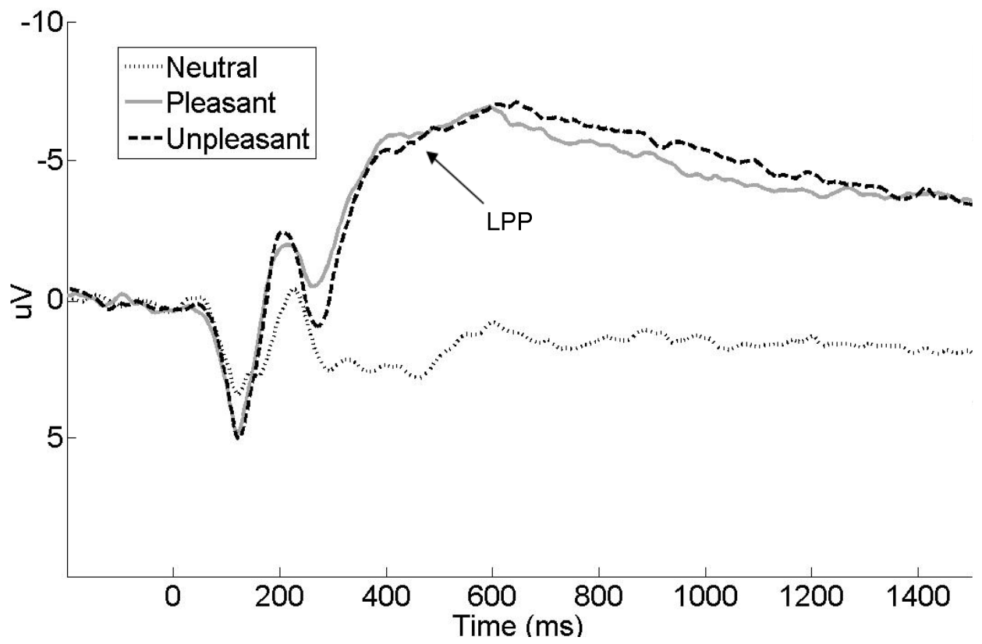
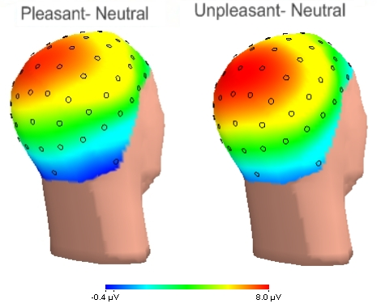
Emotion-Related Components: LPP
Late Positive Potential
Reflects arousal, not valence
Relationship with P3 under debate
Hajcak et al. (2012, Oxford Handbook of ERP Components)
Notes:
Adapted from Hajcak, G., Wienberg, A., MacNamara, A., & Foti, D. (2012). ERPs and the study of emotion. In S. J. Luck & E. S. Kappenman (Eds.), The Oxford Handbook of Event-Related Potential Components (pp. 441-472). New York: Oxford University Press. © Oxford University Press.

